Slide 1

New Approaches and Possibilities in Android 4.4 KitKat API
Zoran Kos*, Zlatko Stapić
 | University of Zagreb Faculty of Organization and Informatics Pavlinska 2, 42000 Varaždin, Croatia http://www.foi.unizg.hr/
* Student at University of Zagreb, FOI Varazdin
CASE26 – Developers conference - 03.06.2014. – Zagreb, Croatia

Slide 2
Agenda
Introduction
Comparing KitKat and Jelly Bean
Conclusion
Android 4.4. KitKat API
New possibilities in KitKat
Live examples on smartphone

Slide 3
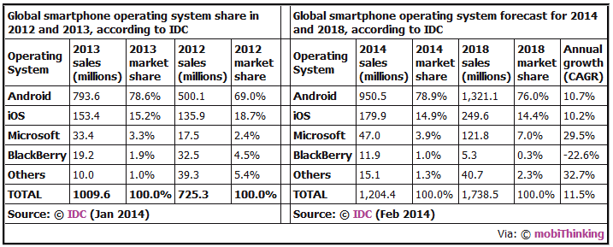
Introdaction 1/2
The first appearance of the Android OS on a mobile devices
Android API development
Global smartphone OS statistics

Slide 4
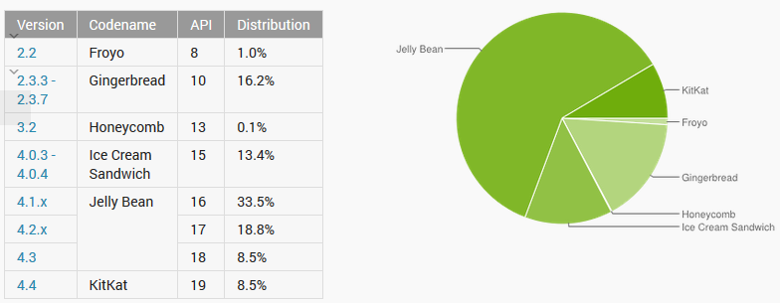
Introdaction 2/2
Android version history
Android version statistics
Relative number of devices running on given version of the Android platform:
Source: [3] Android Developers, May 2014.

Slide 5

Android 4.4. KitKat API 1/2
Slogan: “Smart, simple, and truly yours“
Google “Svelte” project
Kitkat was first introduced in September 2013.
Initially available only on Google Nexus 5
Two important features
Optimal amout of RAM is 512 MB and 340 MB is the minumum
Great support for Google Cloud services
Target SDK version: 19

Slide 6
Android 4.4. KitKat API 2/2
Generally speaking, KitKat is smoothly polished and it offers a huge number of applications that are built into the OS and give great benefits to users and developers.
New capabilities of Android 4.4.
1) New Memory Management
2) New File Management (Google cloud support)
3) System-wide Wireless Printing
4) Step counting built-in Sensors
5) Full Screen Read (Immersive) Mode
6) Smarter caller ID
7) Faster Multitasking (improved touch screen)
8) Quick Office – working with documents
9) Widgets in lock screen
10) New Alarm System Notification
11) Chrome web view
12) Infrared blasting (TV-remote control)
13) Application sandboxes
15) Low-power location monitoring
16) Bluetooth Message Access Profile (MAP) Support

Slide 7
New possibilities in KitKat
Memory Management
File Management
System-wide Wireless Printing and Integration with existing Claud Storage
Android transition framework

Slide 8
Memory Management 1/3
Better support to developers and Original Equipment Manufactures
New API called ActivityManager.isLowRamDevice();
System memory is reduced with:
Trimmed system_server and System UI processes (saved several MBs)
Preload .dex caches in Dalvik (saved several MBs in process virtual machine).
Validated Dalvic JIT-off option (just-in-time compiler option saves up to 1.5MB per process).
Reduced per-process font cache overhead.
Introduced ArrayMap, ArraySet and used extensively in framework as a lighter-footprint replacement for HashMap, HashSet.

Slide 9
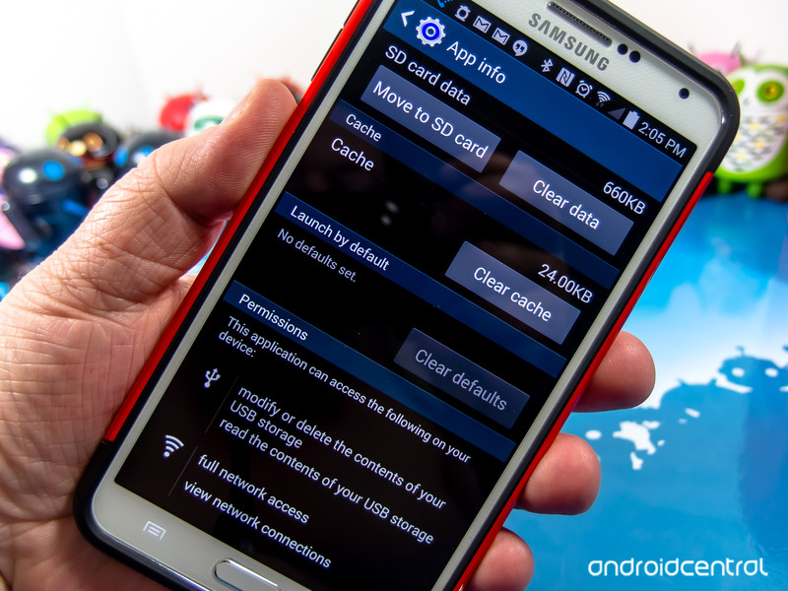
Memory Management 2/3
Offers safer and neater work due to the use of Application sandboxes with Security-Enhanced Linux.
Problems with content that was created by previous API versions on the SD memory card and other external media.

Slide 10
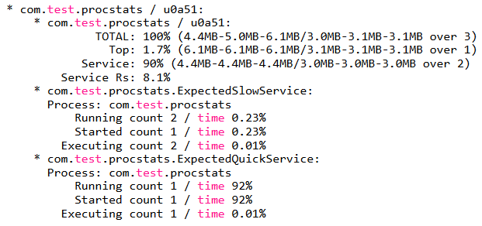
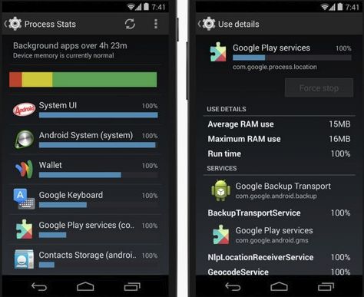
Memory Management 3/3
Developers can use better monitoring of the work memory and timeline with next certain tools and activities:
New tool procstats GUI inside device settings;
New adb shell dumpsys procstats command-line - details about memory use over time, with run times and memory footprint;
New adb shell dumpsysmeminfo (similar to tool-set procrank);
Toll bugreports over adb shell- the batterystats, procstats, usage stats and netstats services;

Slide 11
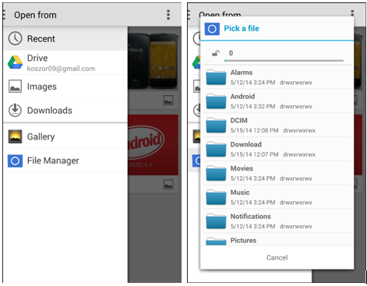
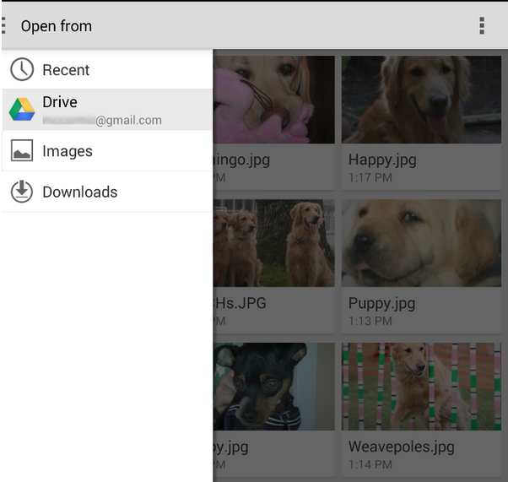
Storage access framework 1/2
Users can interact with stored content as images, videos and documents.
The SAF includes the following:
Client app – can be integrated with the SAF in few lines of code
Document provider - offers read and write access to durable files, such as files stored on a local disk, or files in cloud storage;
Picker - system UI that lets user access documents from document providers that satisfy the client app’ search criteria.

Slide 12
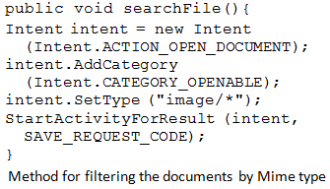
Storage access framework 2/2
Apps that are requesting content will need to be updated to support the new SAF;
Apps that wish to share their content to other apps also need to be updated to allow access by the new framework.
App’s can’t read or write shared files on the external storage while they are running, unless they have
READ_EXTERNAL_STORAGE permission or
WRITE_EXTERNAL_STORAGE permission.

Slide 13
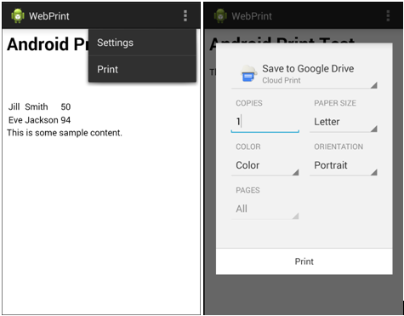
System-wide wireless printing 1/2
Feature to print documents and photos right from the phone;
Direct support for Google Cloud Print, a technology connecting printers to the cloud;
Before printing each document has to be converted to PDF file;
Printer manufacturers (OEM) can use new APIs to develop their own printing services.

Slide 14
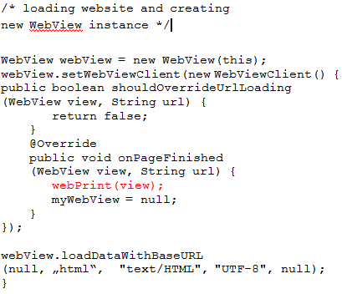
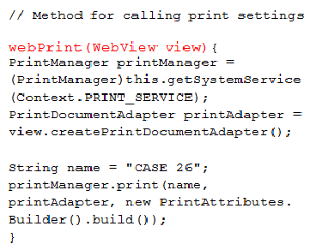
System-wide wireless printing 2/2
By combining Cloud Storage and Cloud print technologies developers got a possibility to save files with high reliability and availability.
WebView class based on Chromium; latest version supports HTML5 features, CSS3, V8 JavaScript engine and remote debugging of WebView content.

Slide 15
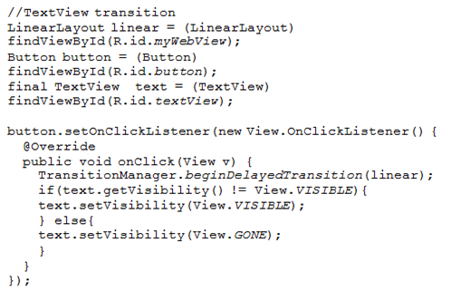
Android transition framework 1/2
This framework makes animation seasier to use and make;
Developers have now more control over animations, they can build complex animations with minimal hours;
Simple property animation by importing libraries:
android.Transitions
android.tranisition.TransitionManager

Slide 16
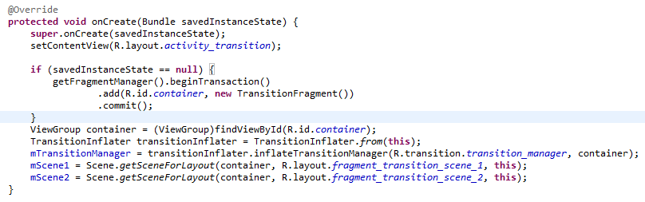
Android transition framework 2/2
To transition between two scenes, developers generally need to perform the following (Android Developers 2013b):
Specify the ViewGroup containing the UI components you want to change.
Specify the layout representing the end-result of the change (the next scene).
Specify the type of transition that should animate the layout change.
Execute the transition.
Container is a ViewGroup that holds the views in the scene.
A Scene contains metadata describing the properties of a layout that are necessary to perform a transition.
Transition resource files must be placed in the res/transition folder of the java project.

Slide 17
Comparing KitKat and Jelly Bean 1/2
Difference between Android JellyBean and Kitkat
1) Improved battery usage
2) Supports 4k resolution
3) Multi-sensory user experience
4) Supports tri-core CPU
5) New framework for UI transitions
6) Improved performance and security
7) Disabled access to battery statistics
8) Edge to Edge display provides a comfort for the user in the work
9) Low-power location monitoring
10) Audio tunnelling and monitoring, loudness enhancer
11) More camera options: faster shooting, more accurate focusing, better balance etc.
12) Built-in infrared blaster support and a redesigned downloads app

Slide 18
Comparing KitKat and Jelly Bean 2/2
Android KitKat has a step detector and step counter so that fitness-related apps can track when the user is walking, running, and climbing stairs.
According to all what was previously mentioned, we would surely think that big step was made, but if we look what changes were made between 18 and 19 API in code, then difference is low 2.63%. Only five methods were deleted.

Slide 19
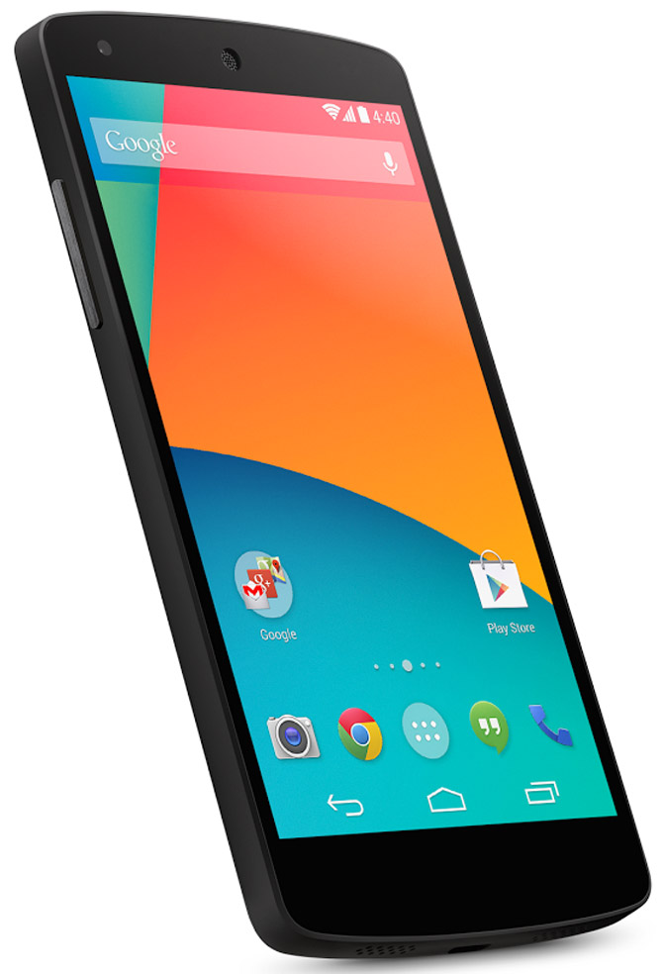
Live examples on smartphone

Slide 20
Conclusion
Android 4.4. KitKat API is 19th API release for Android platform that offers new features for users and app developers.
The main feature of the new mobile OS is adaptation to lower hardware capabilities with less working memory and lower screen resolution.
Google doesn't deliver a huge list of transformative design and feature changes, but provides support that allows developers to develop applications easier.

Slide 21

Looking forward to your questions

Slide 22
References
[1] Allumalla, A.R., 2013. Differencebetween Android Jellybean 4.3 and Kitkat 4.4 / [WWW Document]. Techzost. URL http://blog.techzost.com/4185/difference-android-jellybean-43-kitkat-44/2013/10 (accessed 5.1.14).
[2] Android Developers, 2013. Android 4.4 APIs [WWW Document]. Android Developers. URL https://developer.android.com/about/versions/android-4.4.html#SMS (accessed 5.5.14).
[3] Android Developers, 2014a. Dashboards | Android Developers [WWW Document]. Android Developers. URL http://developer.android.com/about/dashboards/index.html (accessed 4.29.14).
[4] Android Developers, 2014b. Running Android withlow RAM [WWW Document]. Android Developers. URL https://source.android.com/devices/low-ram.html (accessed 4.30.14).
[5] Android Developers, 2014c. Storage Access Framework [WWW Document]. Android Developers. URL https://developer.android.com/guide/topics/providers/document-provider.html (accessed 5.5.14).

Slide 23
References
[6] Chowdhry, A., 2013. 10 OfThe Best Android KitKat Features [WWW Document]. Forbes. URL http://www.forbes.com/sites/amitchowdhry/2013/11/04/10-of-the-best-android-kitkat-features/2/ (accessed 5.12.14).
[7] MobiThinking, 2014. Global mobilestatistics 2014 Part A: handsetmarketshare [WWW Document]. URL http://mobithinking.com/mobile-marketing-tools/latest-mobile-stats/a#smartphone-shipments (accessed 5.8.14).
[8] Rowinski, D., 2013. 10 ThingsDevelopersAndUsersNeed To KnowAbout Android KitKat 4.4 [WWW Document]. ReadWrite. URL http://readwrite.com/2013/11/07/android-kitkat-developers-users (accessed 5.1.14).
[9] Smith, C., 2013. Android KitKat DevelopmentTools - Procstats [WWW Document]. DoubleEncore. URL http://www.doubleencore.com/2013/11/android-kitkat-development-tools/ (accessed 5.12.14).
[10] Wallat, J., 2013. Android 4.4 KitKat: here are the “hidden” functions - AndroidPIT [WWW Document]. AndroidPIT. URL http://www.androidpit.com/android-4-4-hidden-functions (accessed 5.1.14).

Slide 24
Information on authors
Zoran Kos B.Sc
zoran.kos@foi.hr
Zoran Kos is 2nd year student of Information and Programming engineering of Faculty
of Organization and Informatics in Varaždin. Main interests are programming web,
desktop and mobile application, new IT trends like cloud computing and mobility,
making and presenting business models for startup projects. While developing new
apps he focused on front-end development. He already has few smaller but successful
projects behind him.

Slide 25
Information on authors
Zlatko Stapić, PhD.
zlatko.stapic@foi.hr
Faculty of Organization and Informatics
Pavlinska 2, 42000 Varaždin, Tel: +385 42 390 820, Fax: +385 42 213 413
Zlatko Stapić, PhD., works at the Information Systems Development Department at
Faculty of Organization and Informatics in Varaždin. He obtained his PhD in computer
sciences from University of Alcalá (Spain) and in information sciences from University of
Zagreb (Croatia) in cotutelled doctorate program. His scientific and research interests
include software- and mobile applications development methodologies. He participated
in more than 15 scientific and professional projects and published more than 30
scientific and professional papers. Currently he leads the Laboratory for Development
and Transfer of Mobile Technologies (FOI MT-Lab). Zlatko is putting a special focus in
inclusion of students in his scientific and professional activities. The published papers,
projects, awards and other relevant information can be found on his personal website:
http://www.foi.unizg.hr/djelatnici/zlatko.stapic.

